Slide 1
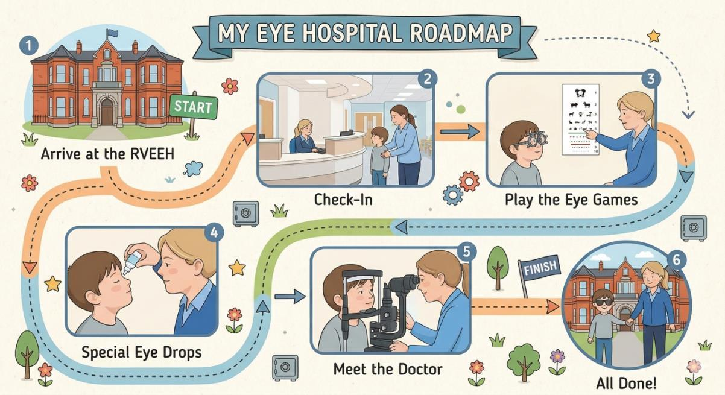
My Visit to the Eye Hospital
Royal Victoria Eye and Ear Hospital

Slide 2
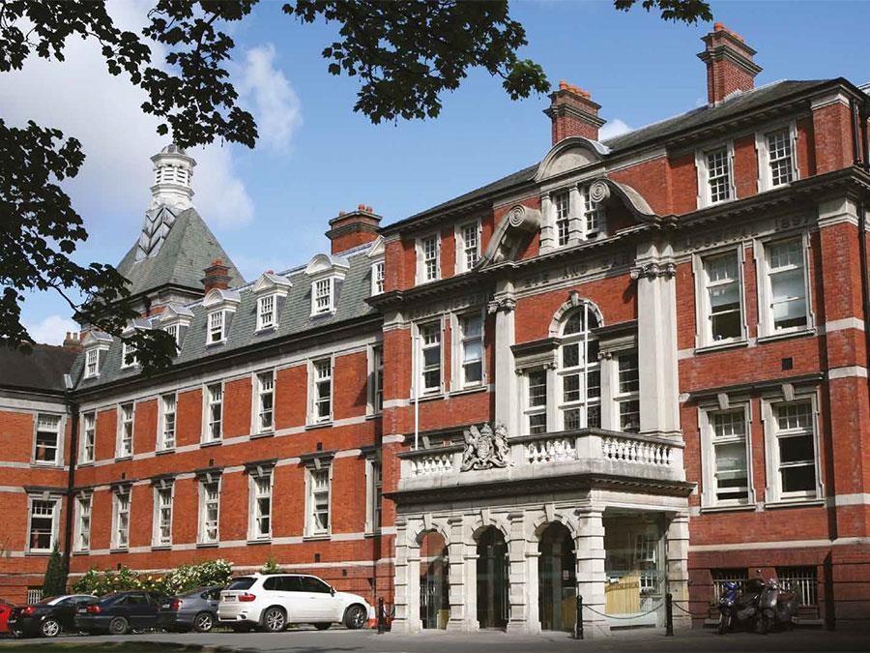
1
We Arrive
This is the hospital. It is a big red brick building.

Slide 3
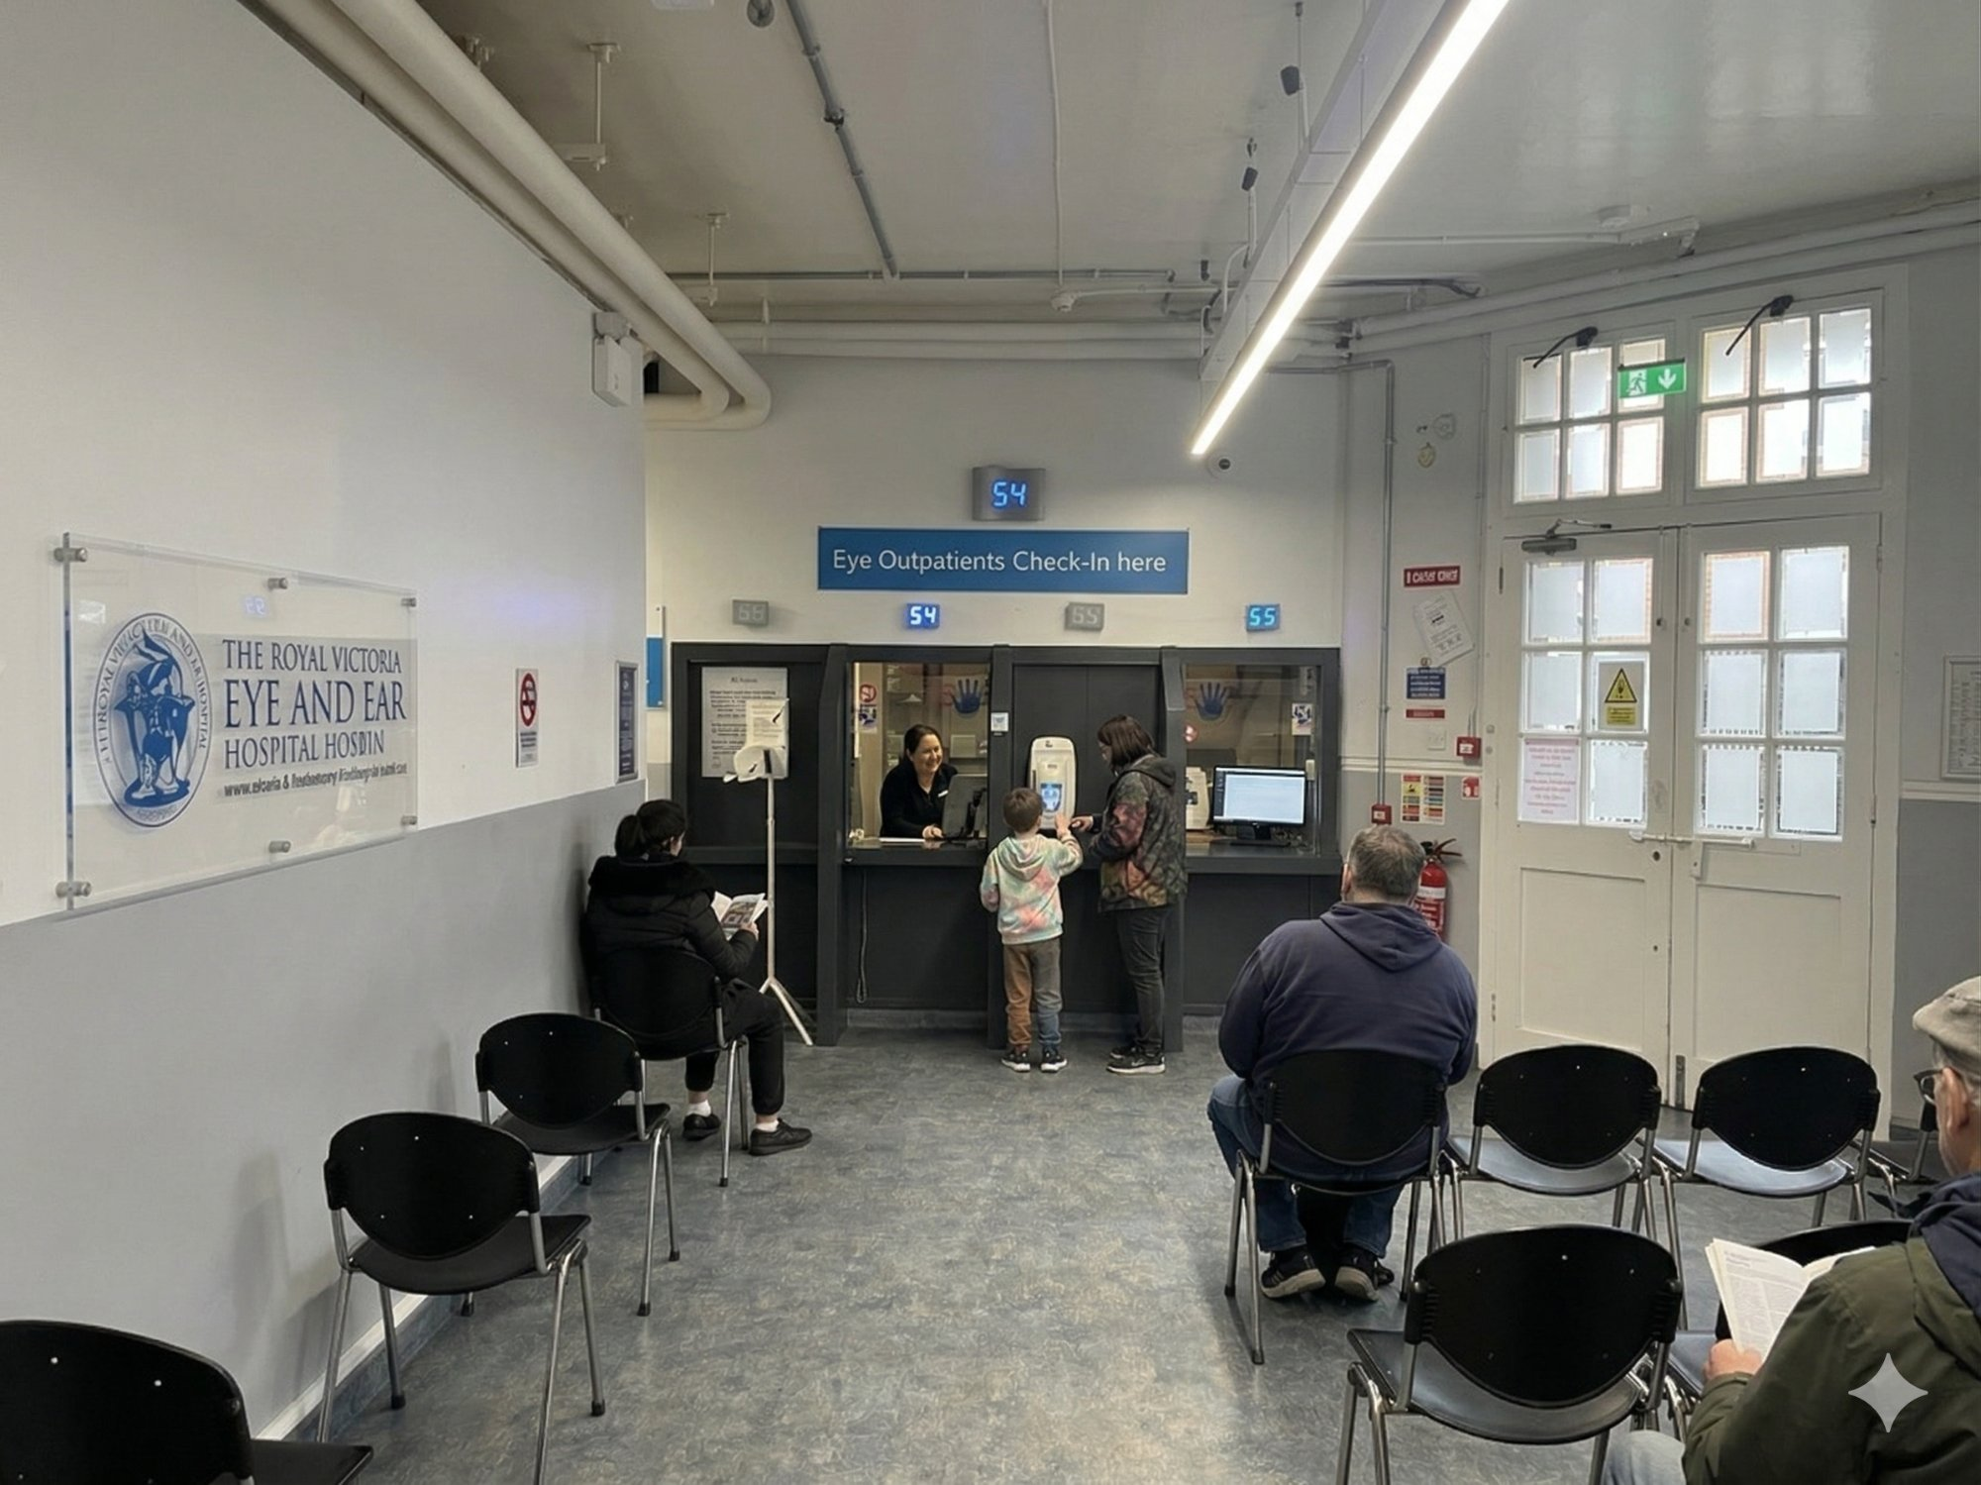
2
Checking In
We go to the desk. A friendly person asks for my name. I wait with my grown-up.

Slide 4
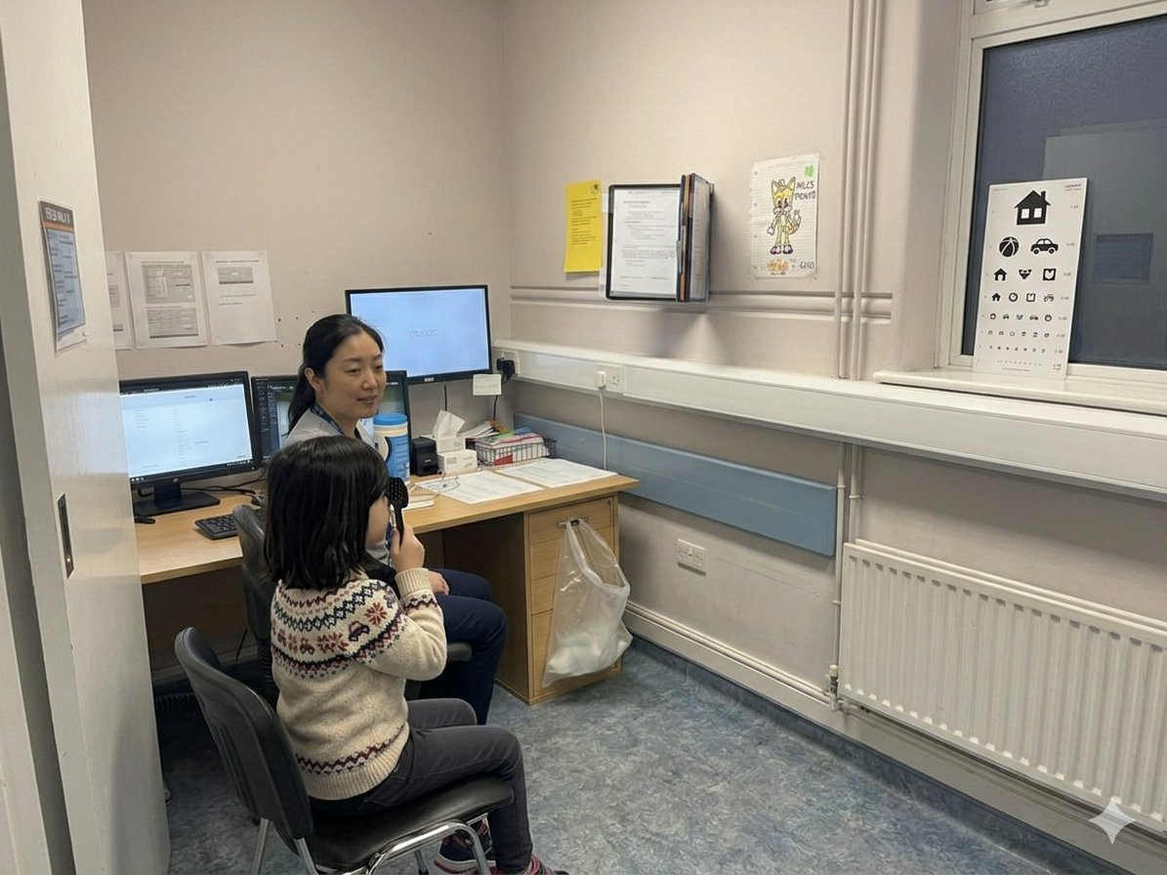
3
The Vision Game
An orthoptist asks me to read some letters or pictures. It does not hurt!

Slide 5
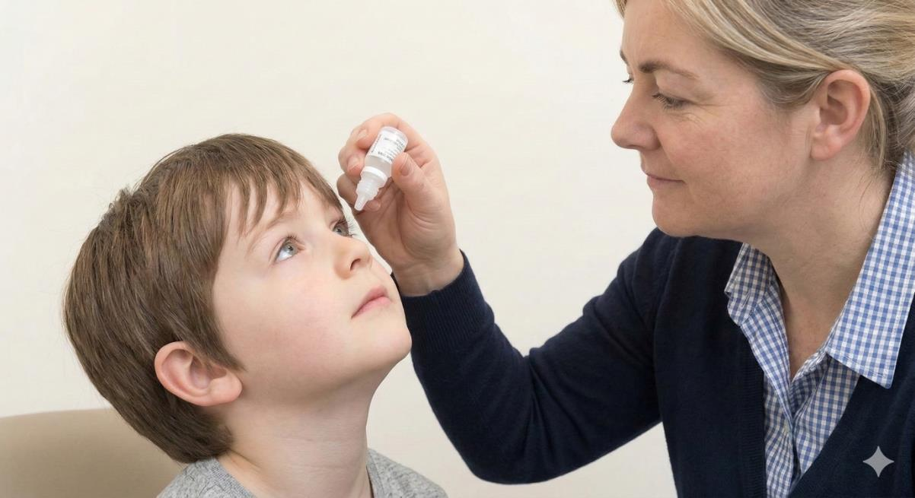
4
Special Eye Drops
The drops might sting for one second. My eyes may go blurry and bright. That is okay.

Slide 6
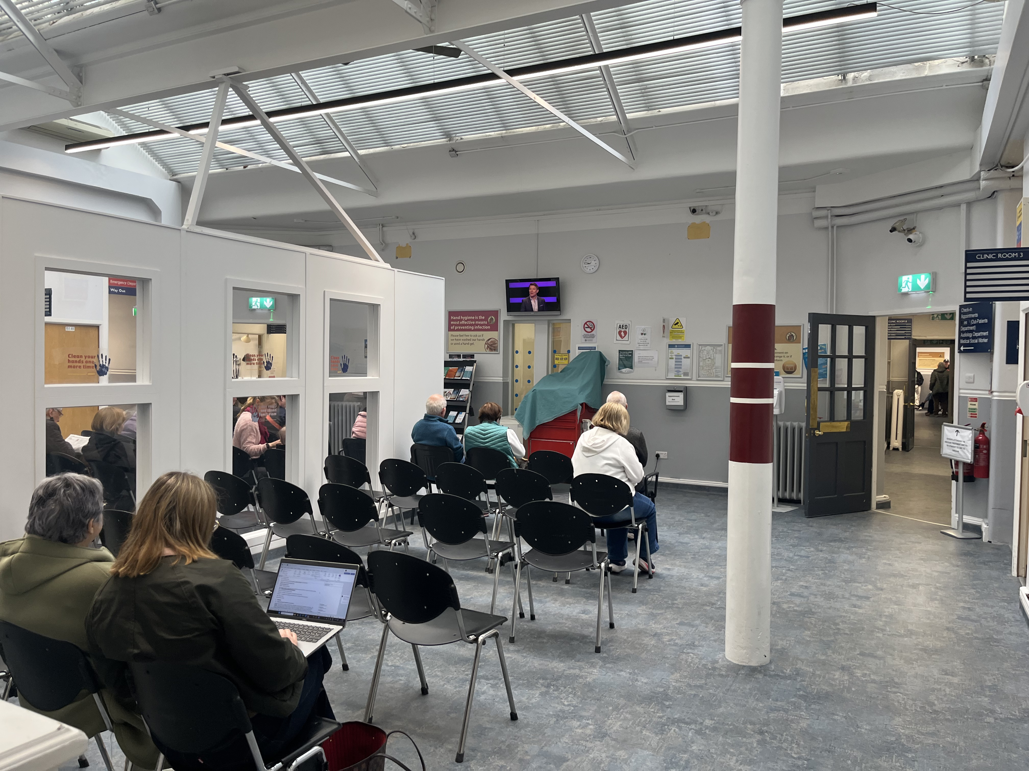
5
Waiting for the Doctor
I sit with my grown-up and wait. I can bring something to hold.

Slide 7
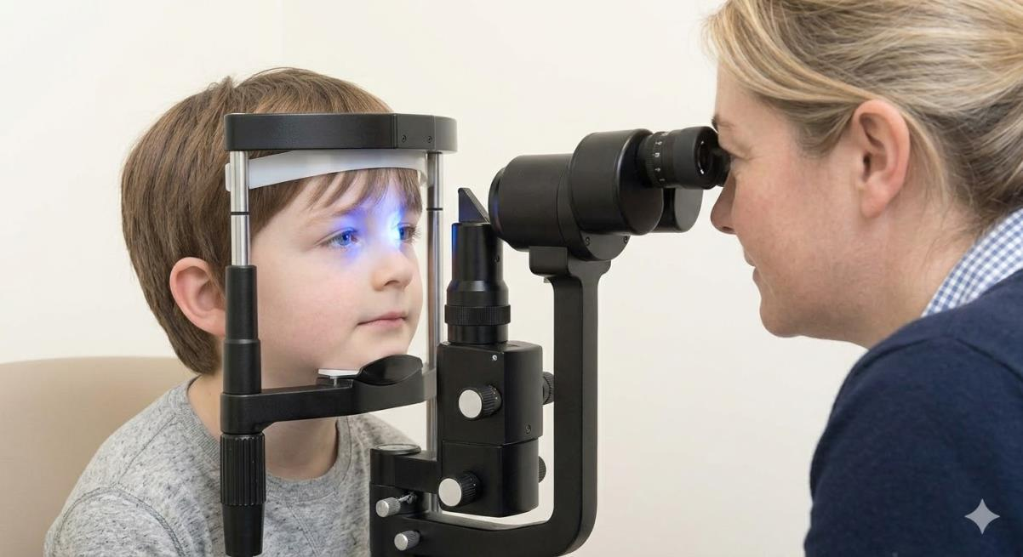
6
Meeting the Doctor
The doctor uses a big microscope called a slit lamp. I rest my chin and stay still.

Slide 8
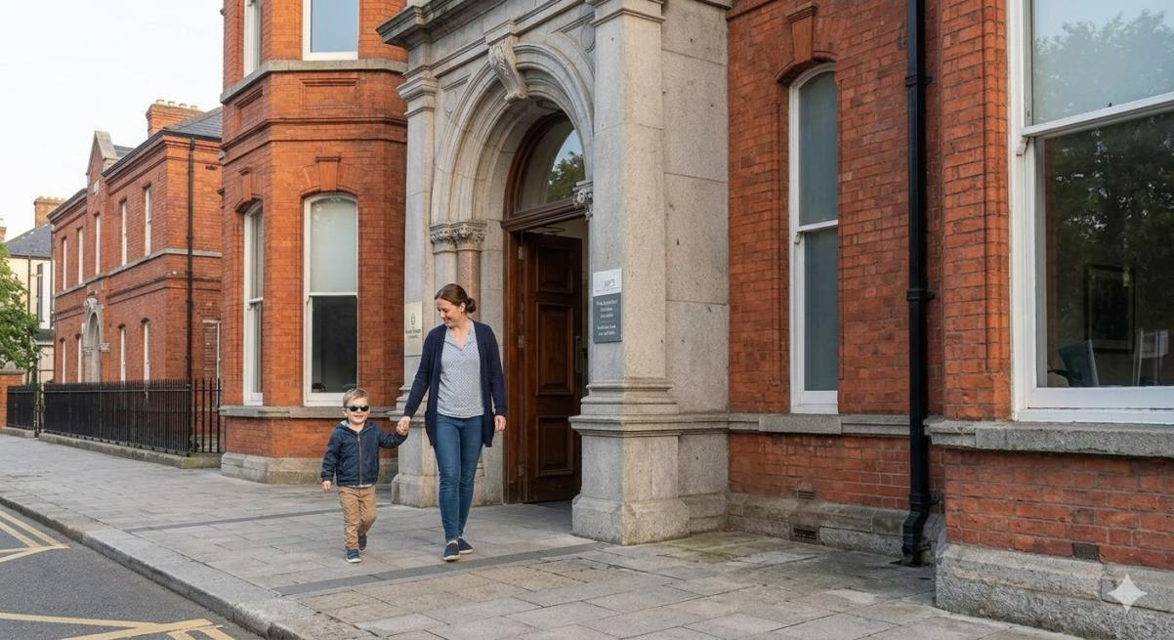
7
All Done! 🌟
I was so brave! I can wear sunglasses outside. Now I can go do something fun.

